Slide 1

Breathing Space Community
Welcome to an Introduction of our new Community Platform “Slack”

Slide 2
Why do we need a new platform?
When Breathing Space started in 2018, there was only one training group and it was easy to communicate via WhatsApp and use Facebook group to share and exchange information.
At the end of 2021, there are now WhatsApp groups for several training courses and apprentices (graduated and still in-training), mentors, and teachers – plus more groups on Facebook for several of the Breathing Space courses and the wider Breathing Space Community.
In the last months, it became more and more clear that this isn’t a sustainable and mentally healthy way of organising and managing a community (which will continue to grow in the next couple of years)!
The amount of messages coming in through various groups and platforms every day got overwhelming and confusing – and the desire to connect with the community actually led many to feel more disconnected as they were trying to figure out where to post about what and when and where to find information that they were looking for…
So it became quite obvious that we needed a new way of connection – and for this also a new platform or tool… which we now have found and are proud to present to you!

Slide 3
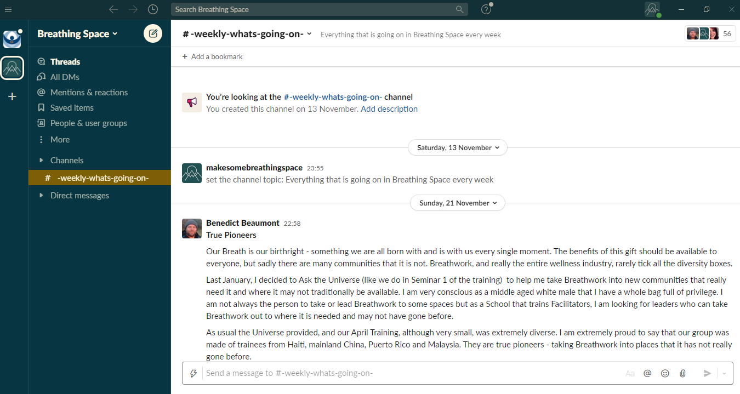
What is Slack & how can I access it?
Slack is a web-based instant-messaging service which enables communication within a workspace and allows people to connect, send message, exchange information and support each other – it‘s everything we want to be able to do in the Breathing Space on ONE platform!
How can you access the Breathing Space workspace on Slack?
Generally, you can use Slack on all your devices and the way it feels most comfortable for you:
Via your Browser
Via the app on your laptop or pc
Via the app on you phone
To enter the Breathing Space community, you can click on this link.

Slide 4
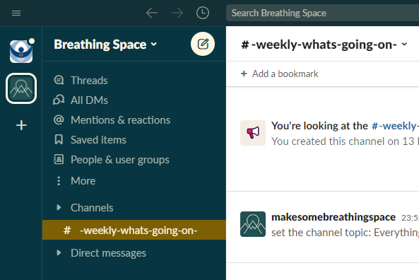
How does Slack work?
Slack is virtual workspace that can only be accessed by people from the Breathing Space community.
When you join Slack, you can see a menu on the left hand side of the screen which allows you to see all the things you can do and the places you can visit within the workshop.
This includes:
CHANNELS – groups (similar to Facebook groups) where you can post messages, files, pictures etc. to other people who are in the channel with you
DIRECT MESSAGES – send private individual 1:1 and group messages to people
The screen shots in this presentation are showing how Slack looks and works on the Windows app. If you use Slack on your phone, it might look different but the functionalities are all the same!

Slide 5
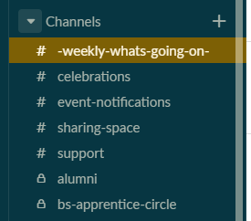
Working within channels (1)
There are two types of channels:
The ones with a hashtag (#) in front of the title are open channels which everybody who is part of the Breathing Space Community has access to.
Those with a lock before the title are closed or private channels. You will only have access to those channels when they are relevant for you (e.g. when you are part of the training course or the teacher group).
Within the channels, you can post messages, share pictures or files, and respond and react to other people’s messages.

Slide 6
Working within channels (2)
The open channels are created to use for different purposes:
Weekly-Whats-Going-On: For Benedict to share his weekly updates and any events that are happening in Breathing Space (e.g. training seminars, masterclasses, Online Breathing Spaces…) – on this channel, it is only Ben who can post new messages, but everyone is able to respond and react to his messages.
Celebrations: Share your success stories and be celebrated by the Breathing Space community for your awesomeness. You can also share successes of other people here, so they get celebrated!
Event-Notifications: For any events that are coming up (not just from Breathing Space but also your personal events) as well as notifications when OBS & workshops are starting (incl. links to the sessions and the recordings)
Sharing-Space: To just connect with others, share about your life, or anything that doesn’t fit in any of the other open channels!
Support: Ask the Breathing Space community for support on anything Breathwork related

Slide 7
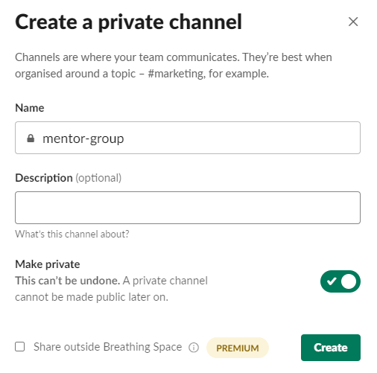
Working within channels (3)
There is a possibility for you to create a channel yourself by clicking on the plus symbol (+) next to “channels” – this might be a good option, if you as a mentor want to create a channel for you and your mentees.
Please ensure, that you set up channels as “private”, so only you and the people you want to be included, get access to this channel! Also this way, there won’t be too many open channels, which might overwhelm or confuse people again.
If you are unsure if you should set up an open or private channel, please check in with Benedict.
Also please note, that in a private channel only members of the group can see what’s been shared (no admin can see or access this channel!)

Slide 8
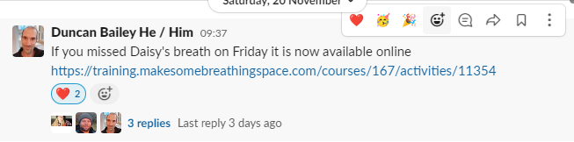
Posting & responding to messages
How to post a message in a channel
At the bottom of each channel, you’ve got the option to “send a message” to this specific channel.
Within this message, you’ve got the possibility to tag people by using @ followed by writing their names.
You can also attach files and pictures to your message.
How to respond and react to a post
To react to a post, you can click directly on the post – a small bar in the right corner of the post will appear which allows you to choose different kinds of reactions.
If you want to respond to a post, please click on the speech bubble – this will open a thread where you can reply (rather than sending a new message at the bottom of the page).
If someone else has responded to the post before, you can also click on the “replies” directly.
You can also react to a post by choosing an emoji (similar to “Likes” on Facebook, just with more options!)

Slide 9
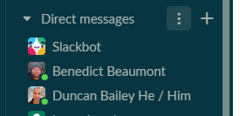
Sending direct messages
Slack can also be used to send direct messages to people – either as a 1:1 message or as a group message (similar to WhatsApp or Facebook Messenger)
You find the Direct Messages directly under your channel list on the left side of your workspace.
Slack normally shows you unread messages in bold.
If you want to send a message to a person, that is not yet listed in your direct messages, you can find them by clicking on the plus sign (+) and type their name in the newly opened window.
You can also create group chats by adding more than one name to a new chat.
Please note, only you will ever be able to see the messages that are sent in a chat (private or group chat) - no admin will be able to see or access your 1:1 and group messages!

Slide 10
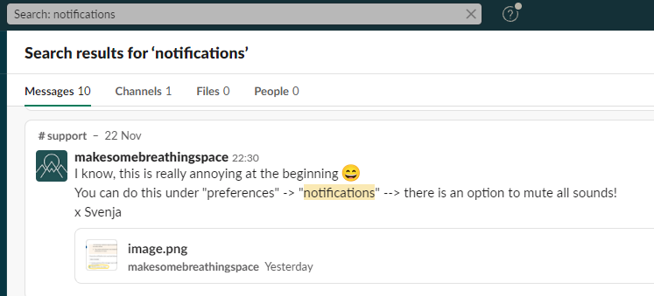
Searching for information on Slack
Let’s say, you remember you have once read something about a specific event happening from one of the Breathing Space facilitators, or you’ve seen a question about a topic that is now relevant for you, and you would like to find this post again, but don’t know where it is… Rather than posting a new message in the #support channel, you can use the search functionality of Slack to find it yourself.
At the top of the workspace window, there is a search bar, where you can enter the term for the topic or question that you are looking for.
Slack will find and show you all messages, posts and channels, that include your search term (if they are posted in an open channel or in one of your messages).

Slide 11
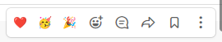
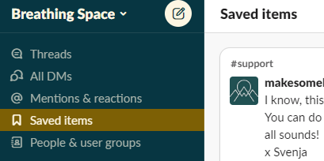
Saving posts that are important to you
If you ever read a message or post, that is important or relevant for you and you want to keep it for later, you can save it.
To save a post or message, you can click on this specific post, so the reaction bar in the right corner of the post will appear. By clicking on the “flag” symbol (the second last symbol in that row), the can save the message for yourself.
All your saved items can be found under “Saved Items” (which is shown in the menu bar on the left side of the workspace.
If you save a post or message, this will only be shown to
and saved for you. Nobody else can see what you save.

Slide 12
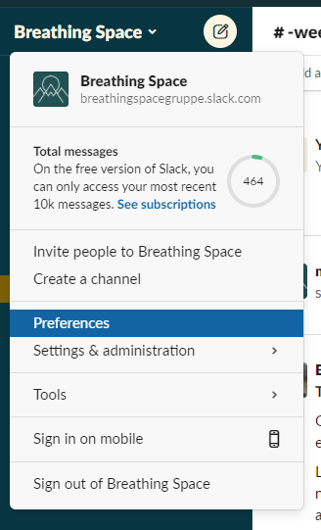
Setting your notifications
When you start using Slack, all notifications are turned on (with sound) – this can be a bit overwhelming at the beginning, especially if you are part of different groups and you get notifications about every new post or message…
We recommend taking a couple of minutes to set your notifications in a way that is supportive for you and the way you want to use Slack (your settings might also depend on if you use Slack on a computer or on a phone).
You can find the setting of your notifications, when you click on the “Breathing Space” in the upper left corner of the workspace, then choose “Preferences” – a new window will open which automatically shows your personal notifications.

Slide 13
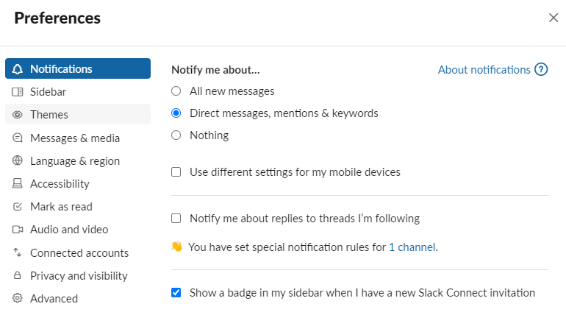
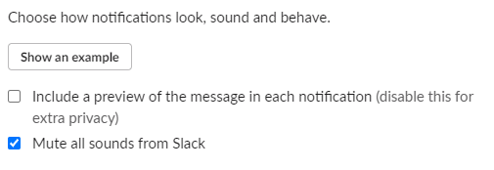
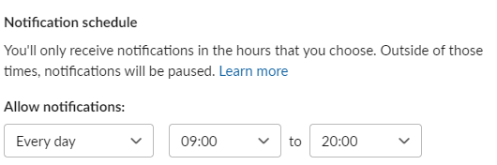
Setting your notifications
In the notification menu, you can decide what you want to be notified about, if you want to use different settings for your different devices, if you want to mute sounds from Slack, and also set specific times for which you allow receiving notifications.
You can also set different notification settings to different channels (e.g. you can turn off notifications for one specific channel completely, but keep it on for another channel). You can do that by…
You can do this, for example, by doing
a right-click with your mouse on a
specific channel in the channel menu
and choosing “change notifications”.

Slide 14
What else needs to be said?
First of all, we hope you are as enthusiastic about Slack as we are! We believe that this is the way forward and Slack will support us to make this community (which is such a big force behind Breathing Space) even stronger and build an even greater sense of connection!
We understand, of course, that not everyone is a fan of new technology and platforms, and that it might need some time to adjust to Slack and how to use it. We do acknowledge this and are happy to support with the transition to this new platform as good as possible.
We will continue to roll out Slack over the next couple of weeks and months for all Breathing Space groups (previous trainings and courses) and will gradually start to close down WhatsApp and Facebook groups to ensure Slack is the platform to use going forward.
If you’ve got questions or have feedback about the usage of Slack for us, please reach out to Benedict or to Svenja (Tasler), who has taken over the role of setting up this platform for Breathing Space.
And, finally: Let’s take a breath together and embark on this new journey of connection! ☺

